Slide 1
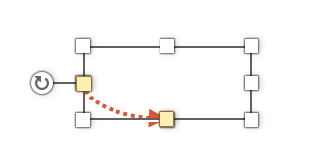
Tool 21
How to use
Replace/add the text in italics
Add further items
To create more textboxes and arrows hold down the “STRG“-key and move the item to the desired position
To drag a new arrow to the correct size click on the arrow and use the corner points to scale. Then move the arrows to the desired position
+
2.
+
STRG
STRG
Pfannenberg/Tessmer/Wecker: JP KOM Toolbox EN

Slide 2
Tool 21
SWOT Analysis
STRENGTHS
WEAKNESSES
Speed
…
Emotionality through rich media
…
…
…
...
...
...
OPPORTUNITIES
THREATS
…
…
…
…
…
…
…
…
Pfannenberg/Tessmer/Wecker: JP KOM Toolbox EN

