Slide 1
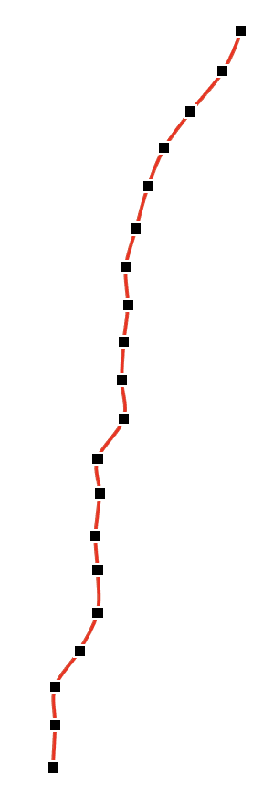
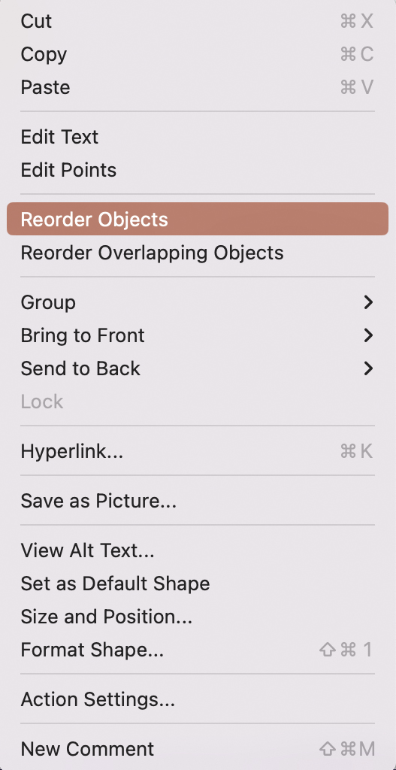
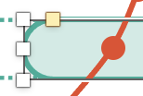
Tool 20
How to use
1.
Replace/add the text of items in italics
To place the points of the graph somewhere else in the table:
Click on the graph with the right mouse button and select “Reorder Objects“
All points are now selected and can be moved individually
Rearrange the colored dots
To duplicate the bar, hold down the "ALT“-key and move the bar to the desired position
Use the corner points to make the bars longer or shorter
+
STRG
+
STRG
Pfannenberg/Tessmer/Wecker: JP KOM Toolbox EN

Slide 2
Tool 20
Gap Analysis
BRAND DRIVERS BY IMPORTANCE
Ø
DEVIATION FROM THE CUT
GAP
Feel good with it
Recommended by friends
Good reputation
Driver
22%
28%
2%
3%
3%
Company 1 Company 2
(cf. Riesenbeck/Perrey 2005)
Pfannenberg/Tessmer/Wecker: JP KOM Toolbox EN

