Slide 1
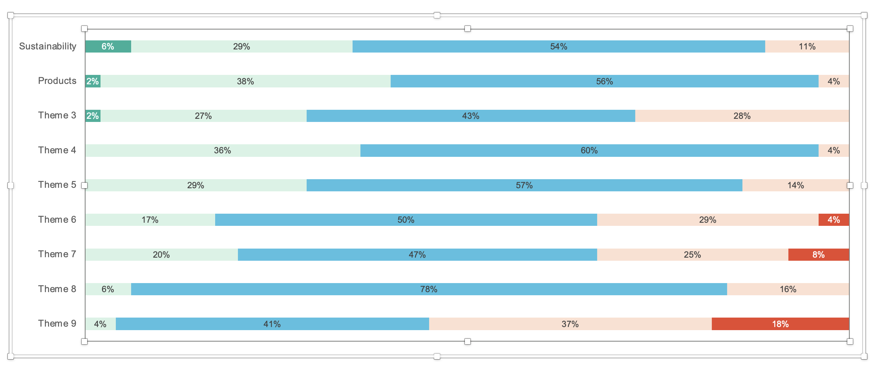
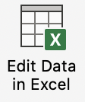
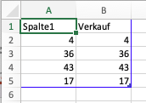
Tool 18
How to use
1.
Replace the text in italics
To adjust the values ​​in the bar chart: 1. Double-click on the graphic 2. Click on “Edit Data in Excel” 3. Enter your data into this Excel table
2.
3.
Pfannenberg/Tessmer/Wecker: JP KOM Toolbox EN

Slide 2
Tool 18
Journalist Survey
Relevance of corporate topics for journalists
1
Very low
2
Low
3
Average
4
High
5
Very high
(news aktuell 2018)
Pfannenberg/Tessmer/Wecker: JP KOM Toolbox EN

