Slide 1
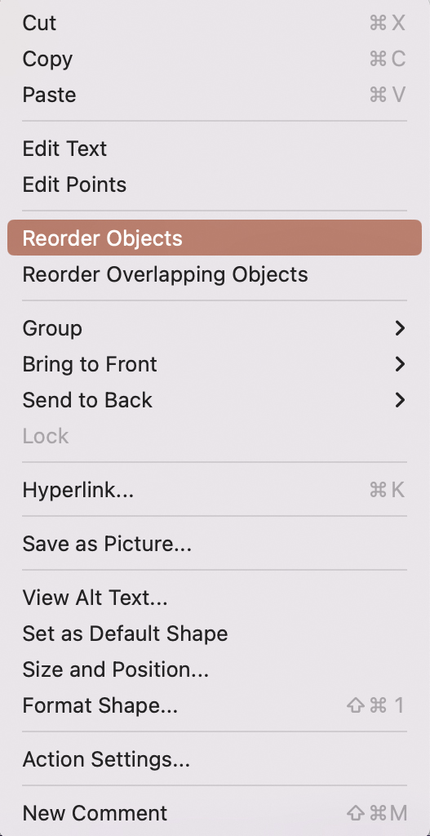
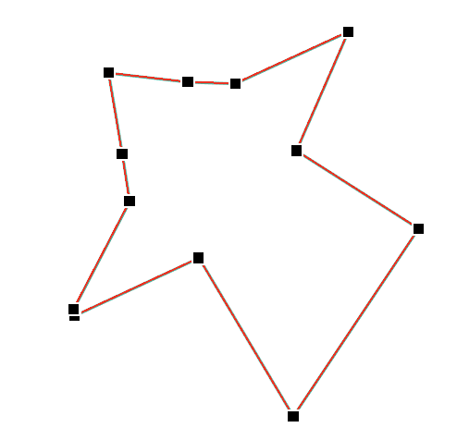
Tool 8
How to use
Enter the values ​​in the circles and place them in the new position
To place the corner points of the graphic somewhere else in the mesh:
Click on the graphic with the right mouse button and select “Reorder Objects“
All points are now selected and can be moved individually
00
Pfannenberg/Tessmer/Wecker: JP KOM Toolbox EN

Slide 2
Tool 8
Cultural Due Diligence
EXTERNAL FOCUS
Denison Organizational Culture Survey
Organizational Learning
Strategic Direction & Intent
Adaptability
Mission
Customer Focus
Goals & Objectives
00
Creating
Change
00
00
00
Values
FLEXIBLE
00
BELIEFS & ASSUMPTIONS
00
STABILE
00
Empowerment
00
Coordination & Integration
00
00
00
Team Orientation
Agreement
00
Consistency
Involvement
Capability Development
Core Values
(Adapted from Adkins/Kaur 2018)
INTERNAL FOCUS
Pfannenberg/Tessmer/Wecker: JP KOM Toolbox EN

