Slide 1
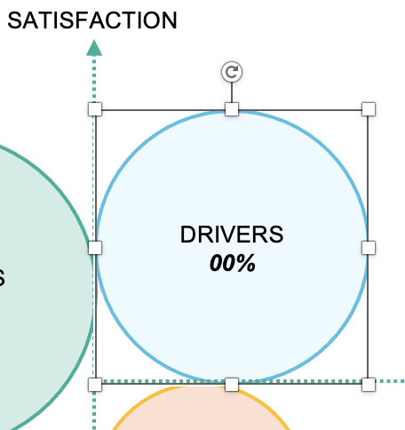
Tool 7
How to use
Enter the numbers in italics
To enlarge or reduce the circles click on a circle with the mouse and holding down the “Shift“-key to drag the circle larger or smaller
Pfannenberg/Tessmer/Wecker: JP KOM Toolbox EN

Slide 2
Tool 7
Commitment Index: Typology
Typology of the employee situation (commitment) in the dimensions Satisfaction and Motivating Environment
SITUATION OF RESIDENTS
Very satisfied
Complete their work without experiencing a very motivating environment
Have a stabilizing effect on the company
Rather security driven
Straight-forward, however need to be directed
SATISFACTION
SITUATION OF DRIVERS
Strong identification with corporate objectives
High level of loyalty to the company
Belief in the future vision and competitiveness of the company
The company provides employees with a motivating environment
High level of willingness to cooperate and self-initiative also inspires and motivates colleagues
DRIVERS 00%
RESIDENTS
00%
MOTIVATING ENVIRONMENT
CRITICS 00%
DETACHED 00%
SITUATION OF DETACHED
Dissatisfied
Disconnected from the company
Discouraged by working environment
More frustrated than committed
Source of contagion for negative atmosphere
Underutilized company resources
SITUATION OF CRITICS
Rather critical and therefore difficult to lead
Strong belief in the competitiveness of the company
Individualistic, interested only in their own professional advancement
Give impulses for change
Ready to change jobs when interesting opportunities show up
(TNS Infratest 2005)
Pfannenberg/Tessmer/Wecker: JP KOM Toolbox EN

