Slide 1
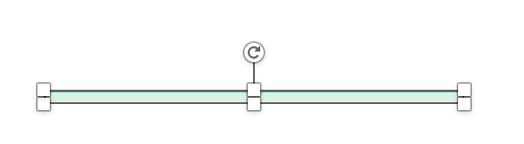

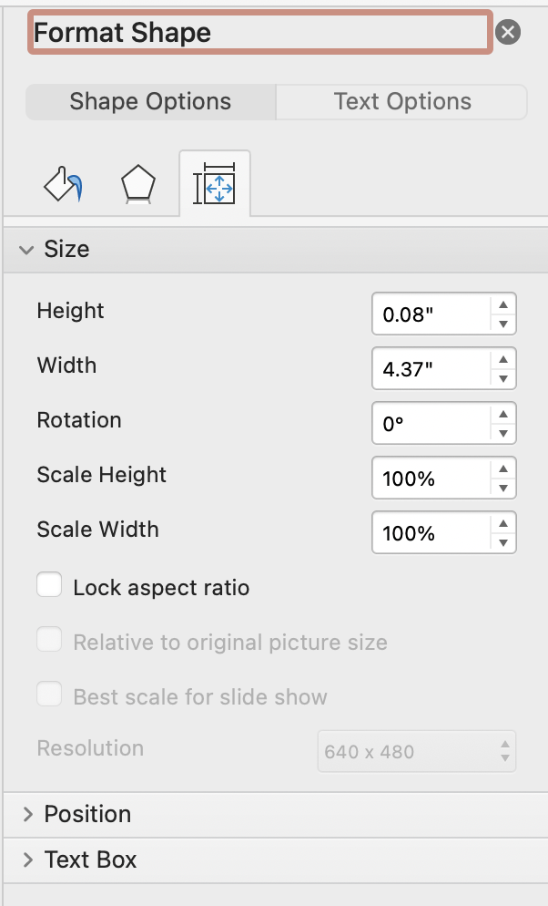
Tool 6
How to use
Replace the text of items and criteria in italics
To lengthen or shorten the bars:
1. Right-click on the bar and select „Size and Position“
2. A window with setting options opens on the right-hand side.
Here you can set how long or short the bar should be
To duplicate the icons, hold down the “STRG“-key and move the icon to the desired position
1.
2.
+
+
STRG
STRG
Pfannenberg/Tessmer/Wecker: JP KOM Toolbox EN

Slide 2
Tool 6
Trust Barometer
Survey results: Importance vs. rating of Trust factors
1
2
3
4
5
Friendliness of the office staff
Friendliness of the cleaning staff
Good manners of the employees
Correct offer preparation
Simple order placement
Flexible agreement of contract and payment modalities
Careful handling of customer property
On schedule performance
Duration of the service provision
Durability of the service provided
Price-performance ratio
Promises are kept
Low staff turnover
Regular supervision by the object manager
Offers and information
Prompt and satisfactory handling of complaints
Customer suggestions are implemented
Understandable accounting
Correctly issued invoices
Gap between Importance and Fulfillment > 0.5
Fulfillment (ACTUAL)
1
Not at all …….. to …….. to a great extent
5
Importance (TARGET)
1
Completely unimportant …….. to …….. very important
5
(According to Wesemeier 2002)
Pfannenberg/Tessmer/Wecker: JP KOM Toolbox EN

