Slide 1
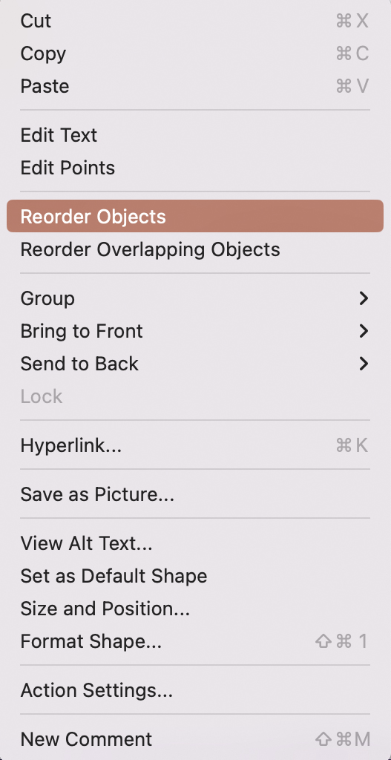
Tool 5
How to use
Replace the figures and text in italics
To place the corner points of the colored areas somewhere else in the mesh:
Click on the colored area with the right mouse button and select “Reorder Objects“
All points are now selected and can be moved individually. The colored areas become bigger or smaller accordingly
Pfannenberg/Tessmer/Wecker: JP KOM Toolbox EN

Slide 2
Tool 5
Image Study/Reputation Quotient
SOCIAL RESPONSIBILITY
Supports good causes
Environmental responsibility
Community responsibility
7
6
VISION & LEADERSHIP
Market opportunities
Excellent leadership
Clear Vision for the future
5
EMOTIONAL APPEAL
Feel good about
Admire and respect
Trust
4
3
2
1
0
0,0
FINANCIAL PERFORMANCE
Outperforms competitors
Record of profitability
Low risk investment
Growth prospects
PRODUCTS & SERVICES
High Quality
Innovative
Value for money
Stands behind
WORKPLACE ENVIRONMENT
Rewards employees fairly
Good place to work
Good employees
Company 1
Company 2
(According to Wiedmann/Fombrun/van Riel 2005)
Pfannenberg/Tessmer/Wecker: JP KOM Toolbox EN

