Slide 1
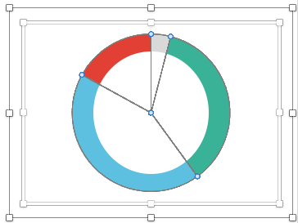
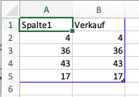
Tool 2
How to use
1.
Replace the text in italics
To adjust the values ​​in the pie chart: 1. Double-click on the graphic 2. Click on “Edit Data in Excel” 3. Enter your data in this Excel table
To add new items/values use the Excel table
2.
3.
Pfannenberg/Tessmer/Wecker: JP KOM Toolbox EN

Slide 2
Tool 2
Stakeholders and Issues
Majority of companies in NRW are concerned with digitization
Do you deal with/are you interested in digital topics?
4% No, but we will make up for it in a timely manner
17% No, digitization is not relevant for us
36% Yes, intensive
43% Yes, on the sidelines
(Bertenrath/Fritsch/Lichtblau/Schleiermacher 2017)
Pfannenberg/Tessmer/Wecker: JP KOM Toolbox EN

Slide 3
Tool 2
Example
Stakeholders and Issues
Decisive factors in the job search
Rank
Global average
USA
China
Germany
Remuneration
Remuneration
Remuneration
Remuneration
1
59%
55%
78%
78%
Type of Activity
Type of Activity
Type of Activity
Type of Activity
2
53%
51%
32%
73%
Advancement opportunities
Advancement opportunities
Advancement opportunities
Advancement opportunities
3
39%
35%
38%
34%
Special services
Special services
Special services
Special services
4
38%
38%
48%
10%
Flexible work design
Flexible work design
Flexible work design
Flexible work design
5
38%
45%
26%
20%
Brand/Image
Brand/Image
Brand/Image
Brand/Image
6
20%
14%
29%
21%
Location
Location
Location
Location
7
34%
33%
28%
40%
(According to Manpower Group Solutions 2017)
Pfannenberg/Tessmer/Wecker: JP KOM Toolbox EN

